Slide 1
Introduction to GIS
Matt Quick
December 7, 2015

Slide 2
What does GIS do?
1) Provides a database framework to integrate spatial and non-spatial data

Slide 3
What does GIS do?
1) Provides a database framework to integrate spatial and non-spatial data
2) Mapping and visualization

Slide 4
What does GIS do?
1) Provides a database framework to integrate spatial and non-spatial data
2) Mapping and visualization
3) Analysis

Slide 5
GIS Software
ArcGIS
- on lab computers
- most popular

Slide 6
GIS Software
ArcGIS
- on lab computers
- most popular
Quantum GIS
- free, open source
- robust user community

Slide 7
Map Projections
Earth is an oblate spheriod.
Computer screens and maps are flat.
Map projections represent spheriods on flat surface. However, often a trade-off between distance, direction, scale, and area.

Slide 8
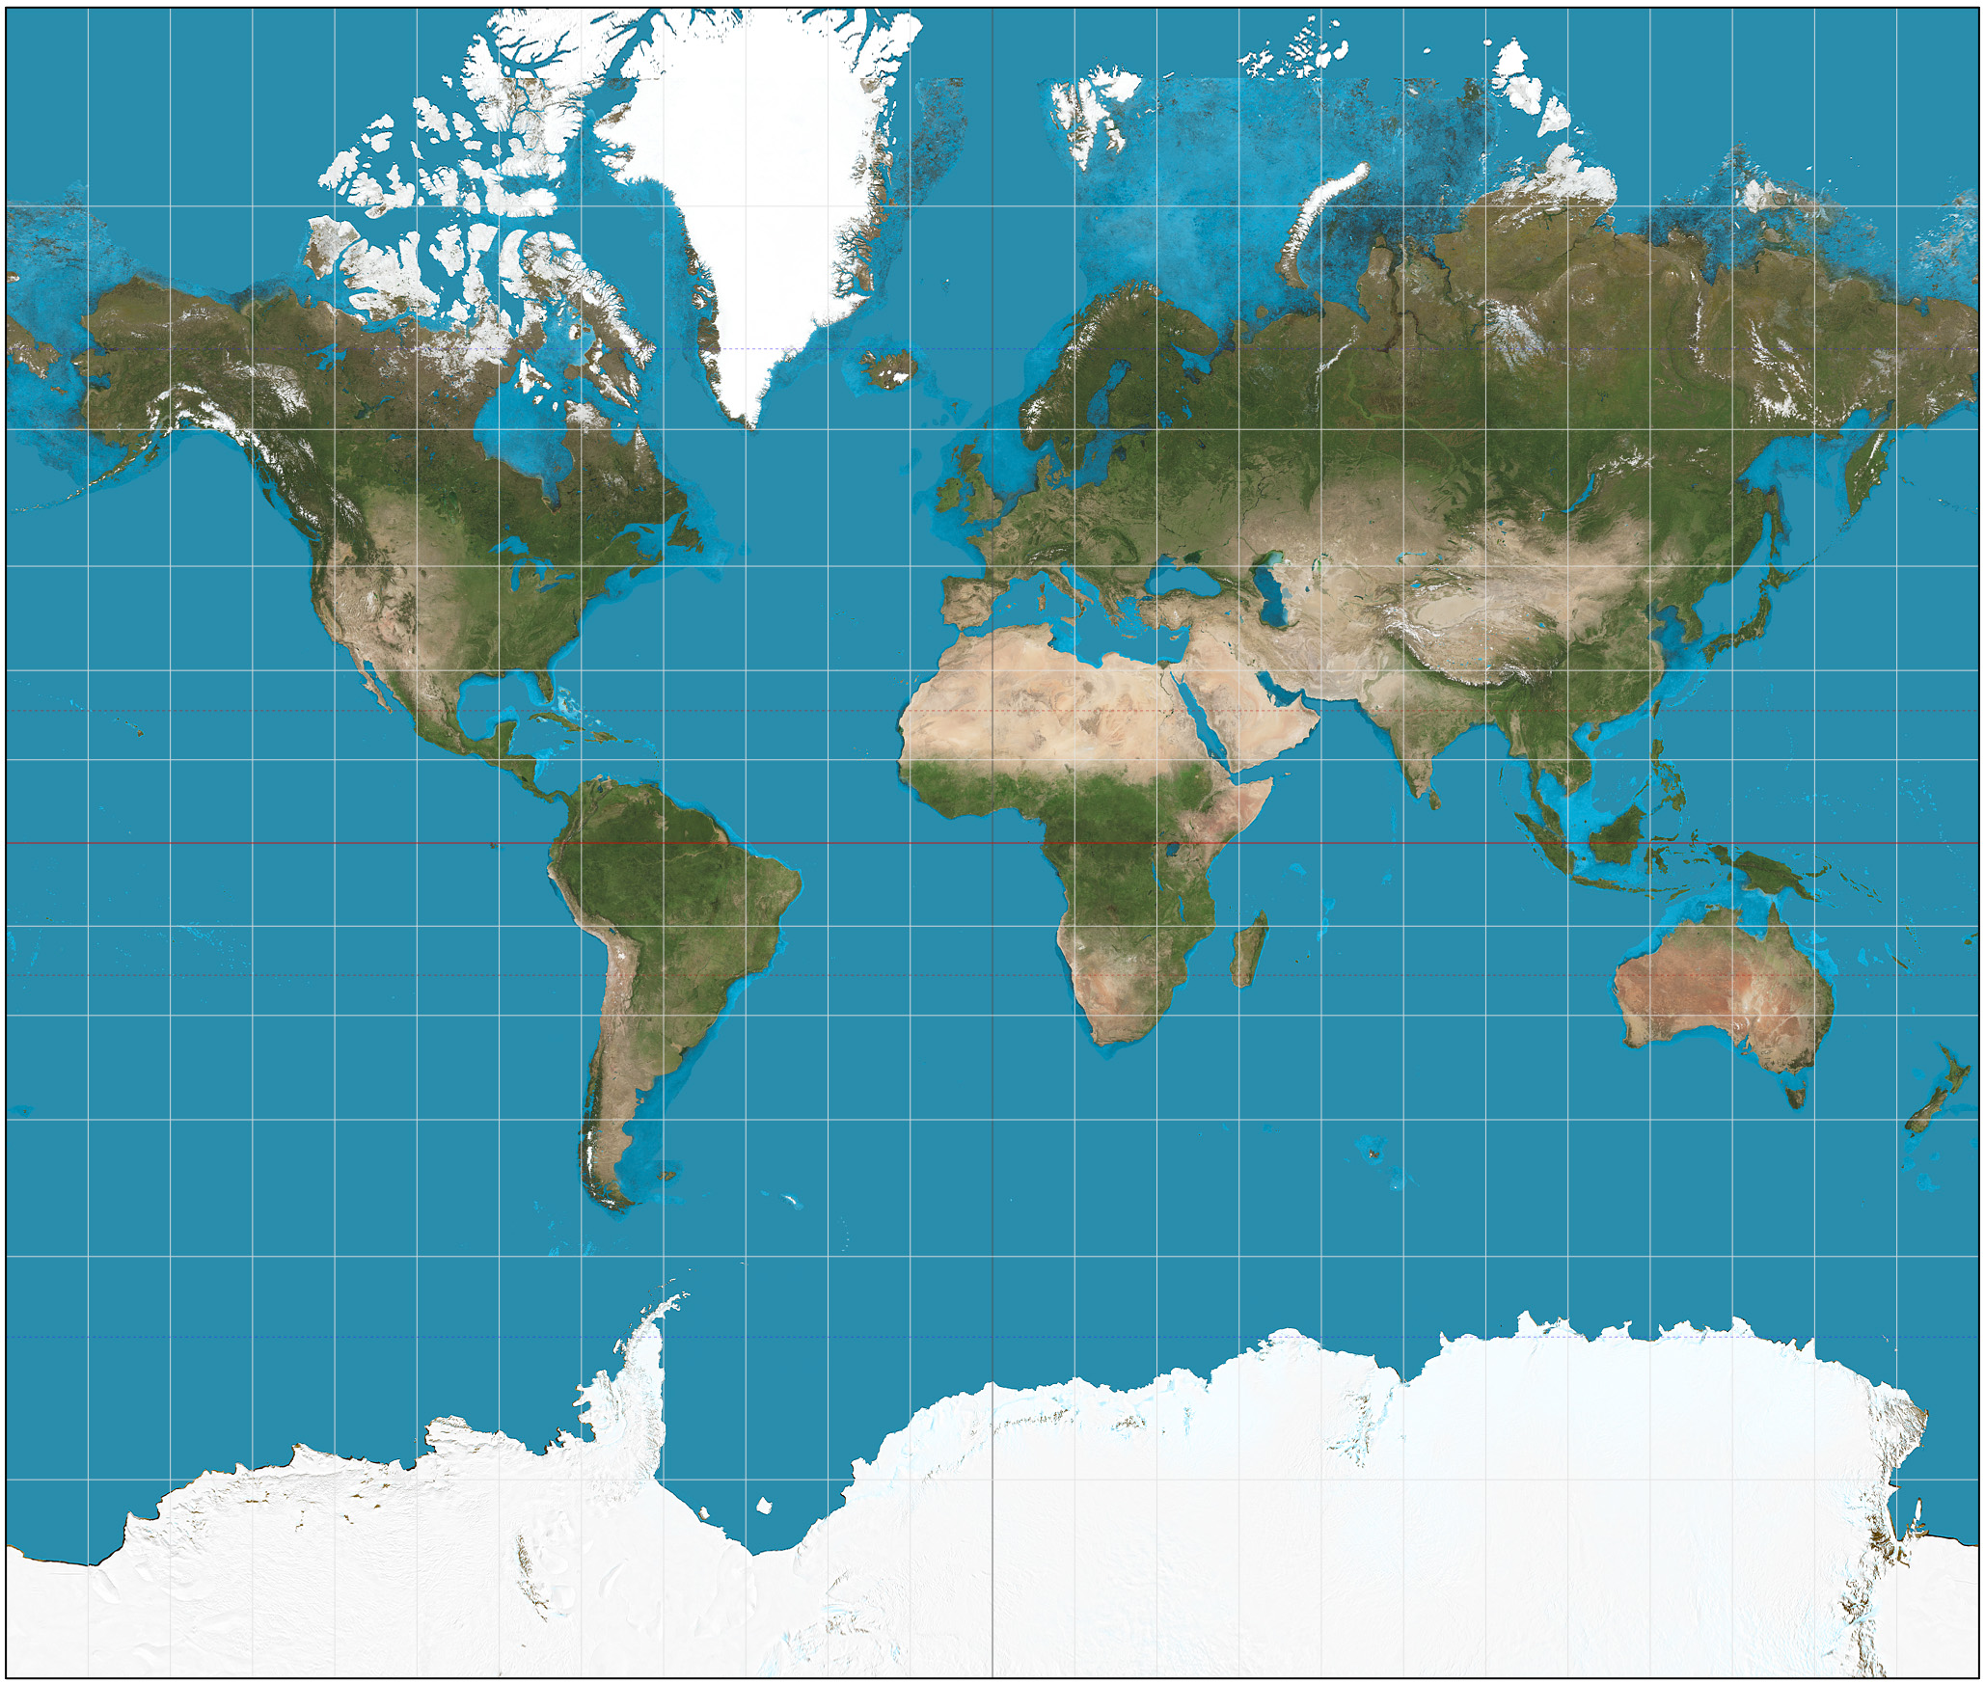

Slide 9
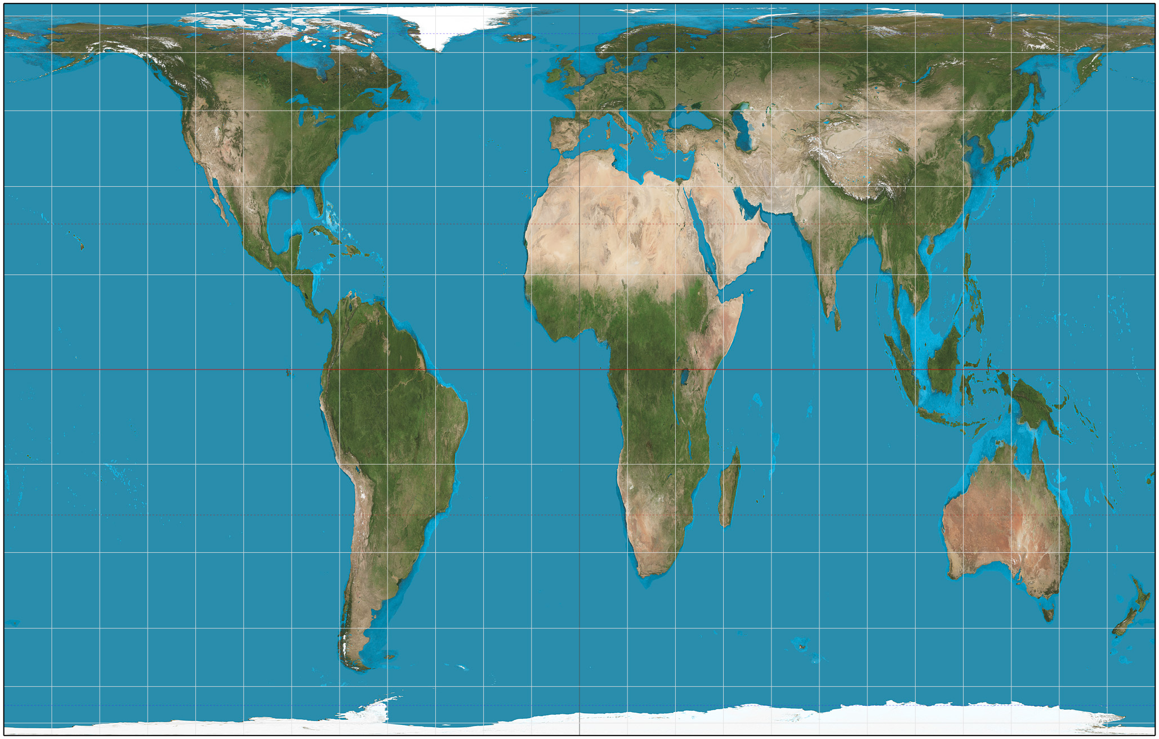
Notes:
http://spatialreference.org/

Slide 10
Spatial Data Types
Raster
- grid cells (rows, columns)
- each cell contains data (temperature, colour, elevation)
Example: Satellite image of Kitchener, each cell contains colour

Slide 11
Raster data picture

Slide 12
Spatial Data Types
Vector
- coordinate-based (x,y)
- points, lines, polygons
- contains data
Example: Hospital with number of beds and doctors

Slide 13
Vector data picture

Slide 14
File types
One or many points, lines, or polygons are a shapefile (.shp).
Shapefiles contain geographic data (x,y) and additional data in the form of a table.

Slide 16
GIS: Exercise
Map census tract average income for Waterloo Region
Overlay transit routes
Notes:
Cool example: http://youarehere.cc/j/subway/philadelphia.html

Slide 17
GIS: Getting Started
Create a folder and remember location. This is where we will store all of our files.
Shapefile data – passed around

Slide 18
Data: Census Tract Income
Census Analyzer:

Slide 19
Data: Census Tract Shapefile
Available from map library
Available online from Statistics Canada

Slide 20
Get Data: Transit Routes
Waterloo Region Open Data Portal
Download “Transit – GRT Routes”

